Slide 1
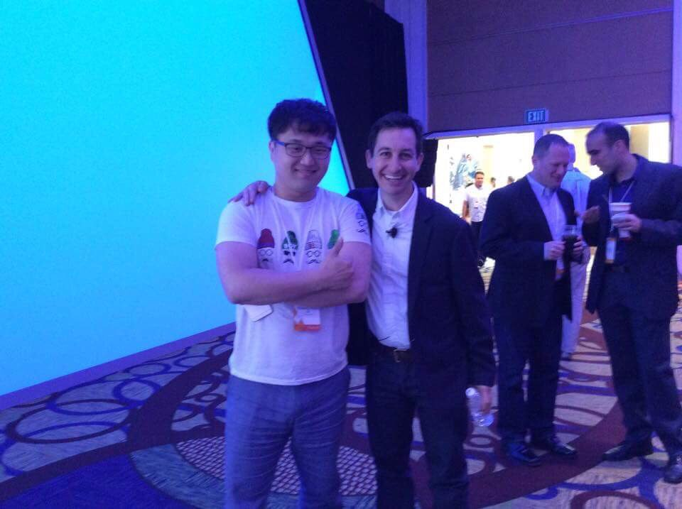


Slide 2
Growth Hackers

Slide 3
Growth Hacking

Slide 4
Growth Hacking

Slide 5
Data Analytics

Slide 6
Contents
1
5
3
What
Case study
How
2
4
Why
Functions

Slide 7
What is it anyway…
WHAT?

Slide 8
digital analytics?
Numbers to Text

Slide 9
digital analytics?
Give them answers

Slide 10
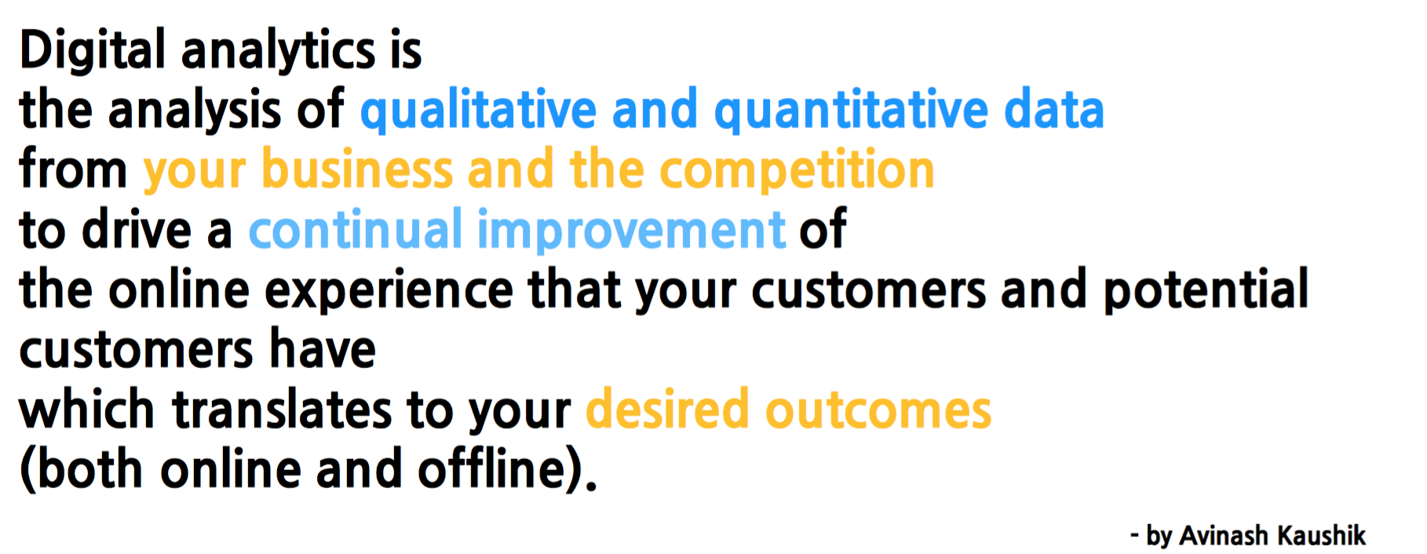
Definition

Slide 11
WHY?
Numbers…. Numbers.... Numbers.....

Slide 12
Purpose
Optimize & Maximize

Slide 13
Reality
Gone….Gone....

Slide 14
Purpose
Minimize abandonment

Slide 15
HOW?
So…

Slide 16
HOW?
Terms
Full understanding of terms is not optional

Slide 17
Page view (PV)
Happens in every single pages
Virtual page view
Repeats, Unique

Slide 18
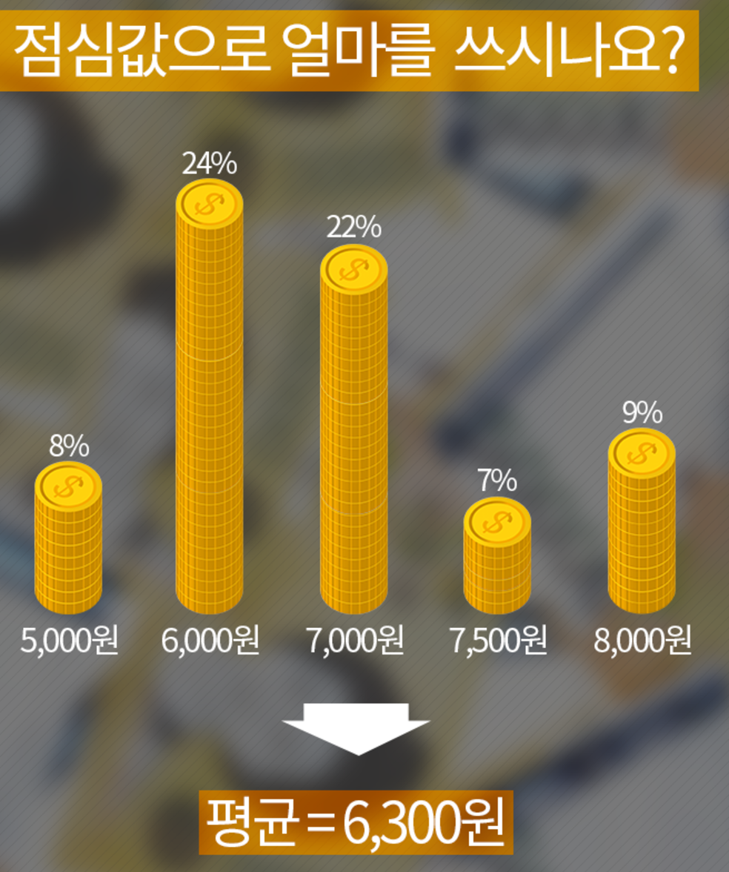
Session

Slide 19
Session

Slide 20
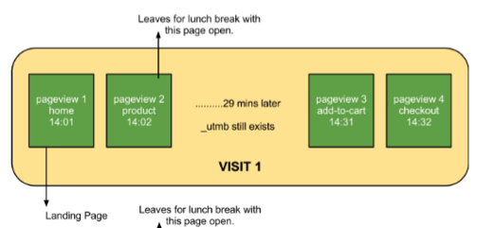
Session

Slide 21
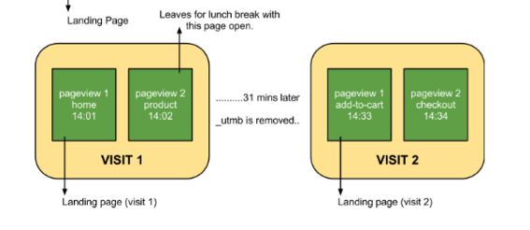
Session

Slide 22
Users

Slide 23
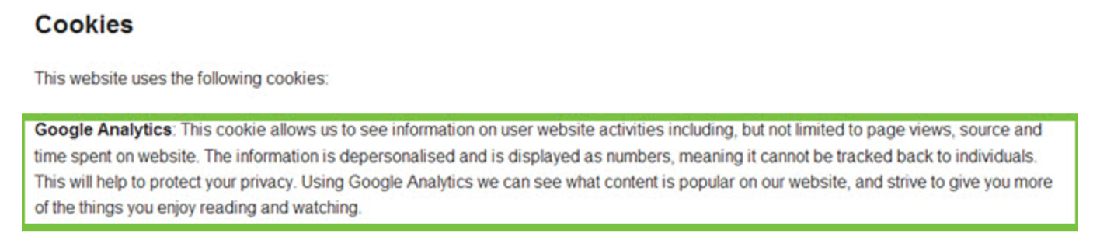
Cookie

Slide 24
Cookie

Slide 25
Bounce
Miss-Clicked
Wrong information
Not enough information

Slide 26
Conversion
Achieve goal
Goals can be anything
Macro / Micro Conversion
Signup, PVs, Purchase etc.

Slide 27
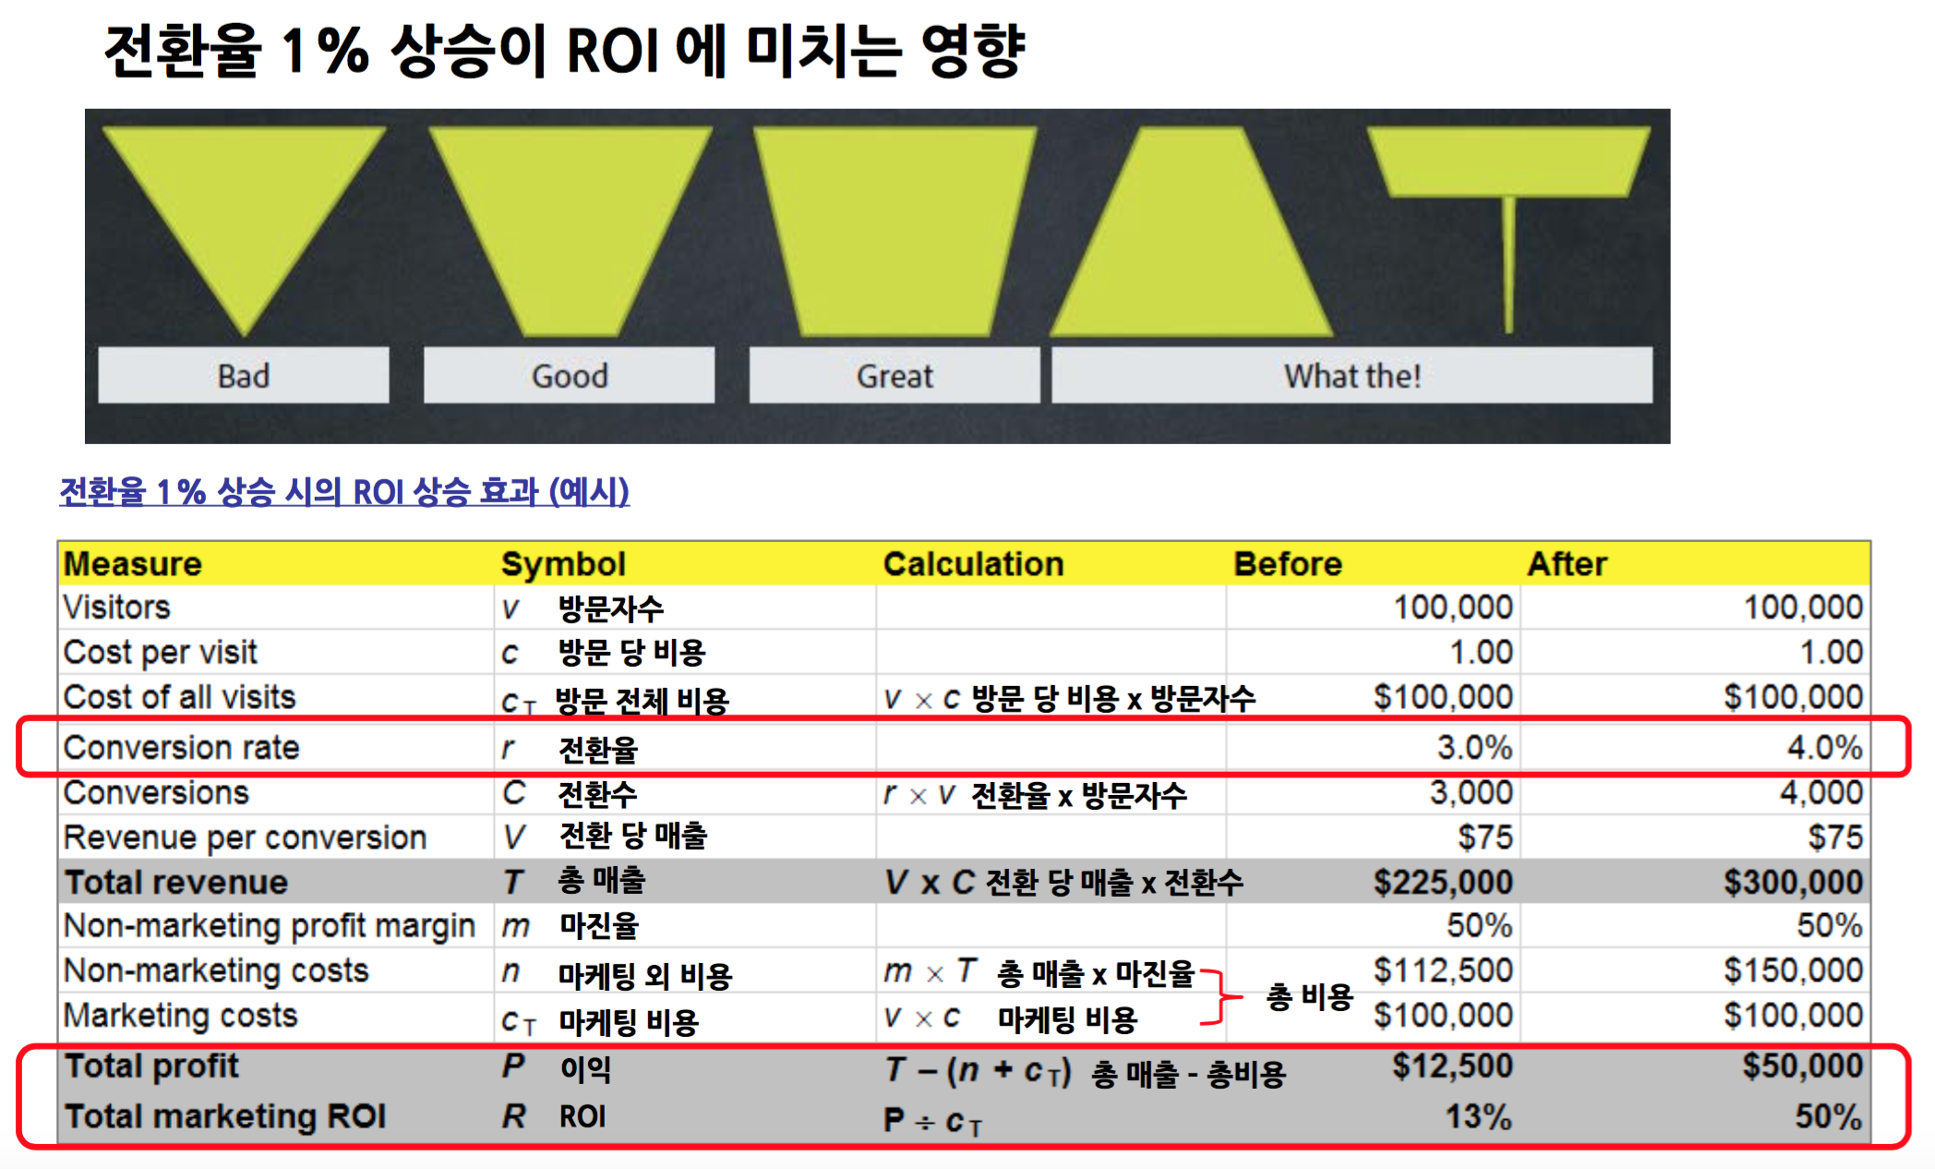
Conversion
Rate

Slide 28
Flows
Only available your own
Full - stack analyst

Slide 29
Short cuts..
Functions

Slide 30
CRM
Customer relation management
Minimize abandonment
Segmented customer group
Personalization

Slide 31
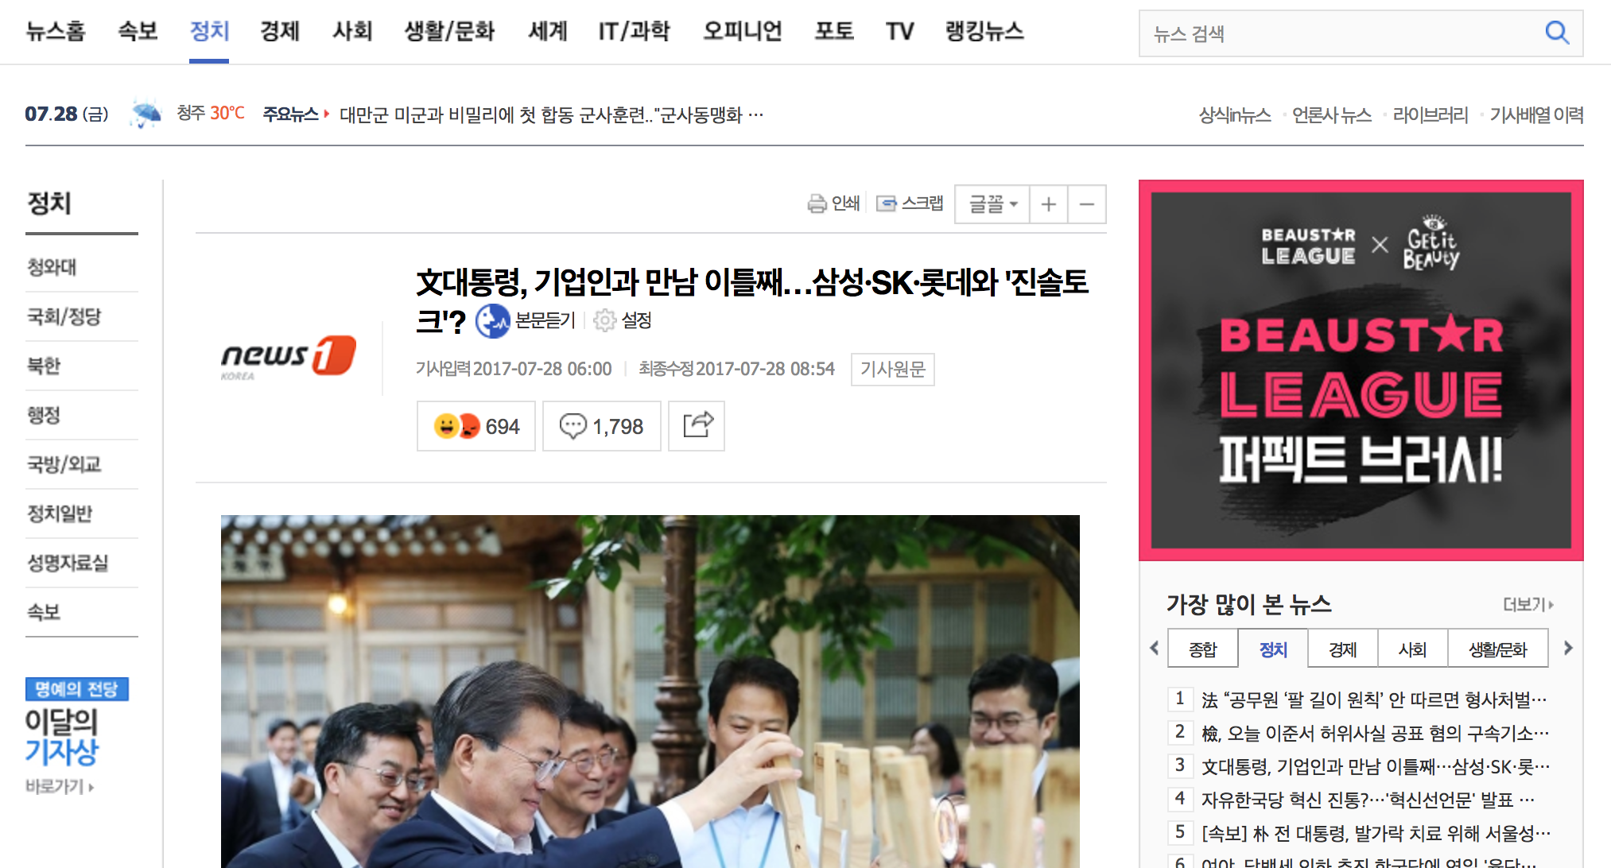
Retargeting

Slide 32
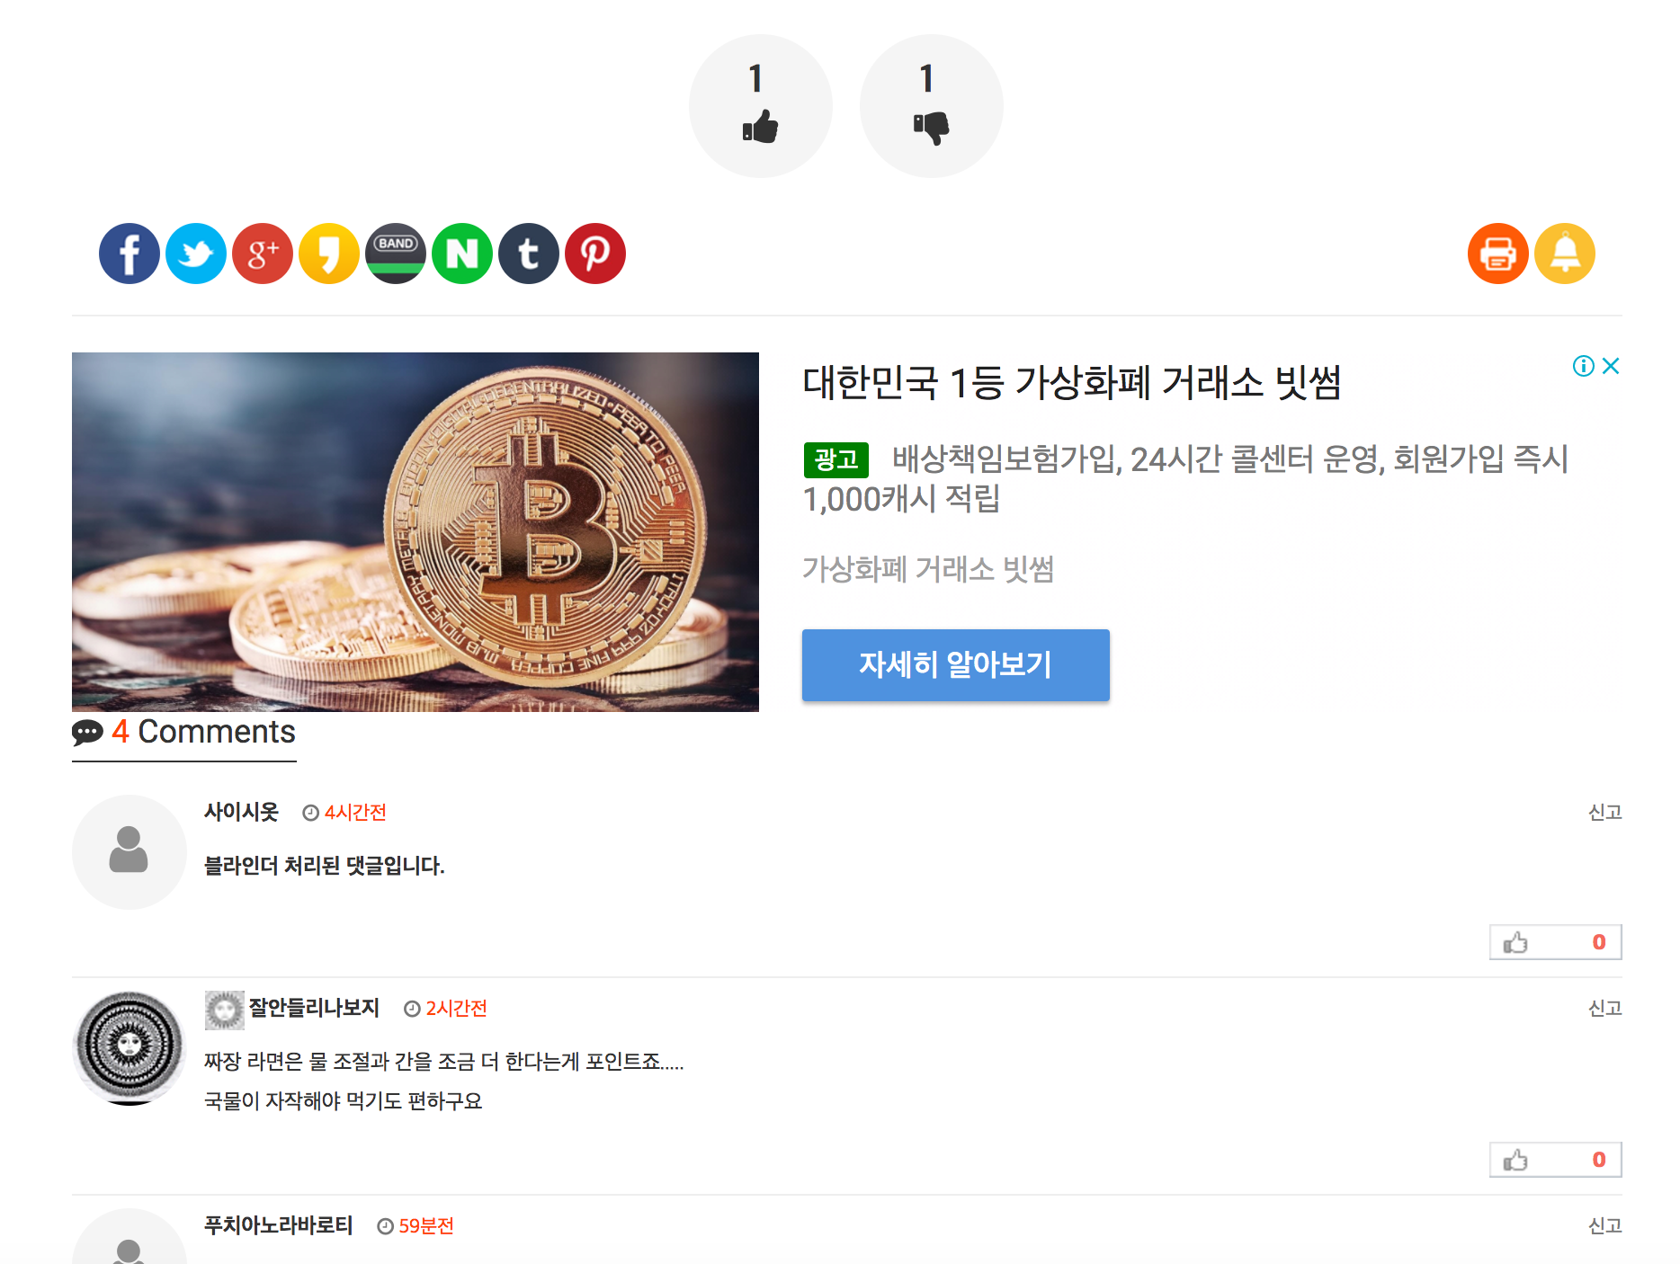
Retargeting

Slide 33
Cross
Device
Multiple devices
But one user
Duplicated user counts

Slide 34
Ggal dde gi
Funnel Analysis

Slide 35
Funnel Analysis

Slide 36
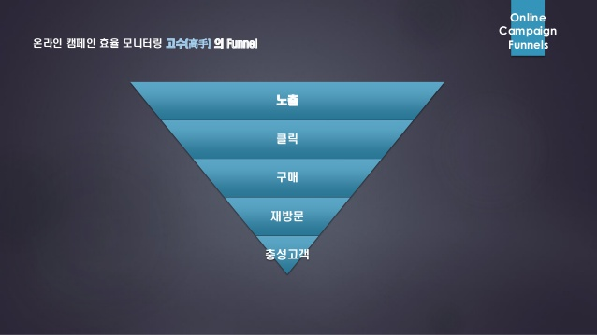
Funnel Analysis

Slide 37
Cohort

Slide 38
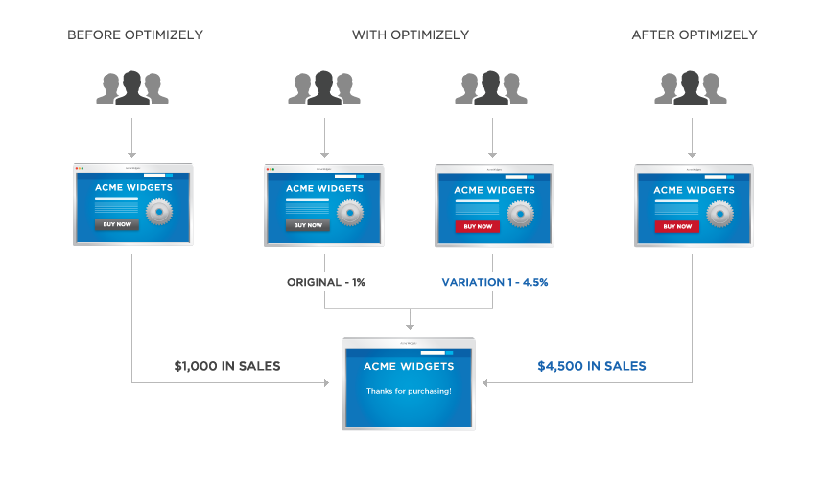
A/B Test
A/B/C Test?
A/A Test?

Slide 39
Marketing
Extra terms
$$$

Slide 40
Terms
GMV
Gross Merchandize Volume
=
ACV
GMV / # of customers
=
AOV
GMV / # of Orders
=
(Mille)
CPM
Cost Per Thousand
=
CPC
Cost Per Click
=
Cost Per Purchase
CPA
Cost Per Action
=
=

Slide 41
Terms
CTR
Click Through Rate
=
DT
Duration Time
=
ROAS
Return on ads spending
=
(GMV / Ad $) * 100
=
Return of investment
(GMV / Invest.) * 100
ROI
=
=
CPP
Cost Per Purchase
=
(GMV / # of purchase) * 100
=
LTV
Life Time Value
=

Slide 43
Case Study
Real life example

Slide 44
Non members purchase
Log-in Register
(Try to) Purchase
Bounced
Not registered
Really Bounced

Slide 45
Non members purchase

Slide 46
Google Analytics
Now GA

Slide 47
Dimension &
Metrics
문제가 되는 부분을 파악하여, 해결한다

Slide 48
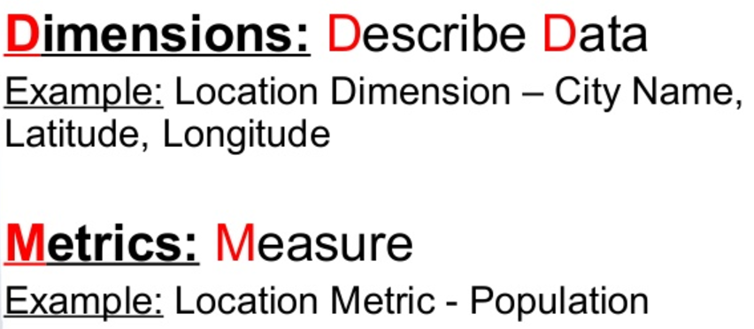
Dimension &
Metrics
문제가 되는 부분을 파악하여, 해결한다

Slide 49
Segmentation
Filter & segment ?

Slide 50
끗
THANK YOU

